Slide 1
Design and Analysis of Algorithms
Algorithms-II : CS345A
Lecture 25
Network Flow – IV
Toward Polynomial time algorithm for Maximum Flow

Slide 2
RECAP of the last Lecture

Slide 3
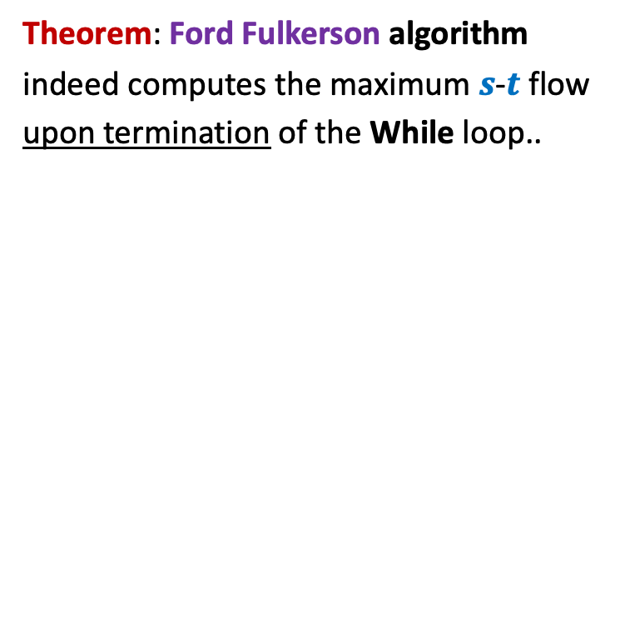
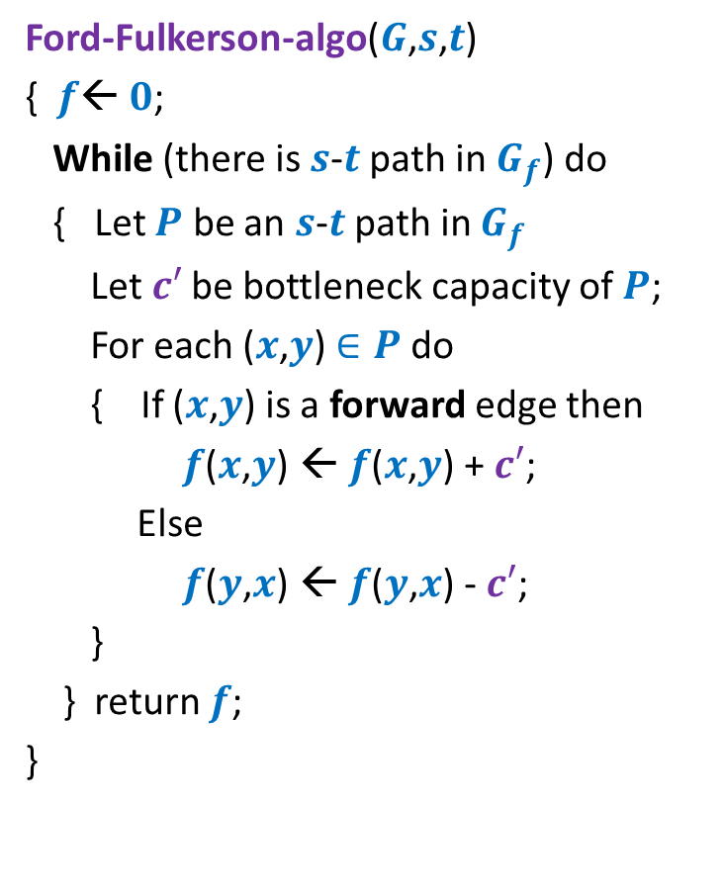
Ford Fulkerson algorithm
Ford-Fulkerson-algo($G$,$s$,$t$)
{ $f$← $0$;
While (there is $s$-$t$ path in $G_{f}$) do
{ Let $P$ be an $s$-$t$ path in $G_{f}$
Let$c′$ be bottleneck capacity of $P$;
For each ($x$,$y$) $∈P$ do
{ If ($x$,$y$) is a forward edge then
$f$($x$,$y$) ← $f$($x$,$y$) + $c′$;
Else
$f$($y$,$x$) ← $f$($y$,$x$) - $c′$;
}
} return $f$;
}
Theorem: Ford Fulkerson algorithm
indeed computes the maximum $s$-$t$ flow
upon termination of the While loop..

Slide 4
Integrality of max-flow
A useful tool for many applications of Max-Flow

Slide 5




Integrality of max-flow
Theorem: Given a network $G$=($V$,$E$), and two vertices $s$,$t∈V$,
if edge capacities are integers, then there exists a maximum $s$-$t$flow $f$
which is “integral”.
$f\left(e\right)∈Z$for each $e∈E$
1
.67
1
.67
1
1
1
$$s$$
1
.33
$$t$$
0
.33
0
1
1

Slide 6
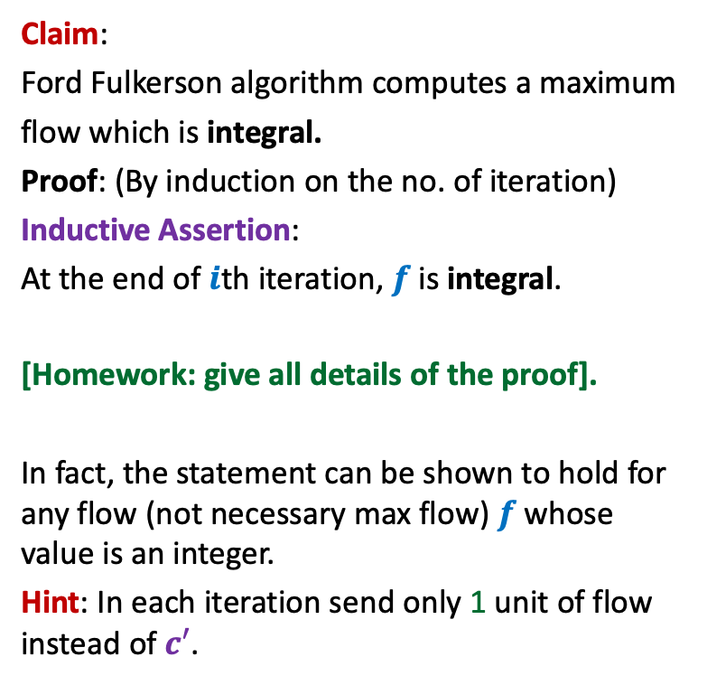
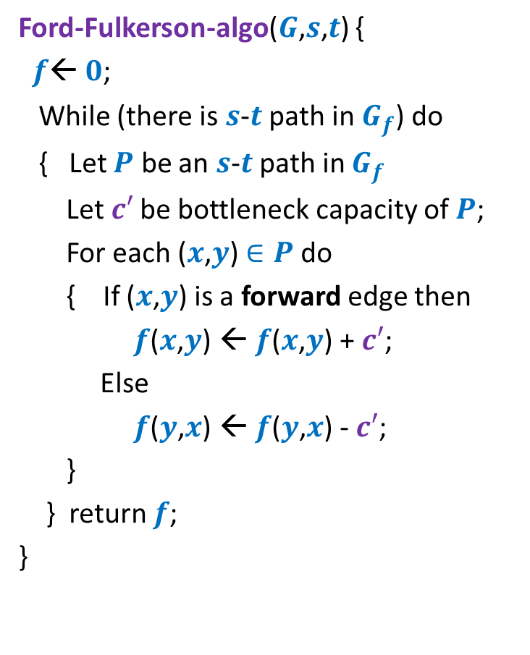
Proof for Integrality theorem
Ford-Fulkerson-algo($G$,$s$,$t$) {
$f$← $0$;
While (there is $s$-$t$ path in $G_{f}$) do
{ Let $P$ be an $s$-$t$ path in $G_{f}$
Let$c′$ be bottleneck capacity of $P$;
For each ($x$,$y$) $∈P$ do
{ If ($x$,$y$) is a forward edge then
$f$($x$,$y$) ← $f$($x$,$y$) + $c′$;
Else
$f$($y$,$x$) ← $f$($y$,$x$) - $c′$;
}
} return $f$;
}
Claim:
Ford Fulkerson algorithm computes a maximum
flow which is integral.
Proof: (By induction on the no. of iteration)
Inductive Assertion:
At the end of $i$th iteration, $f$ is integral.
[Homework: give all details of the proof].
In fact, the statement can be shown to hold for any flow (not necessary max flow) $f$whose value is an integer.
Hint: In each iteration send only 1 unit of flow instead of $c′$.

Slide 7
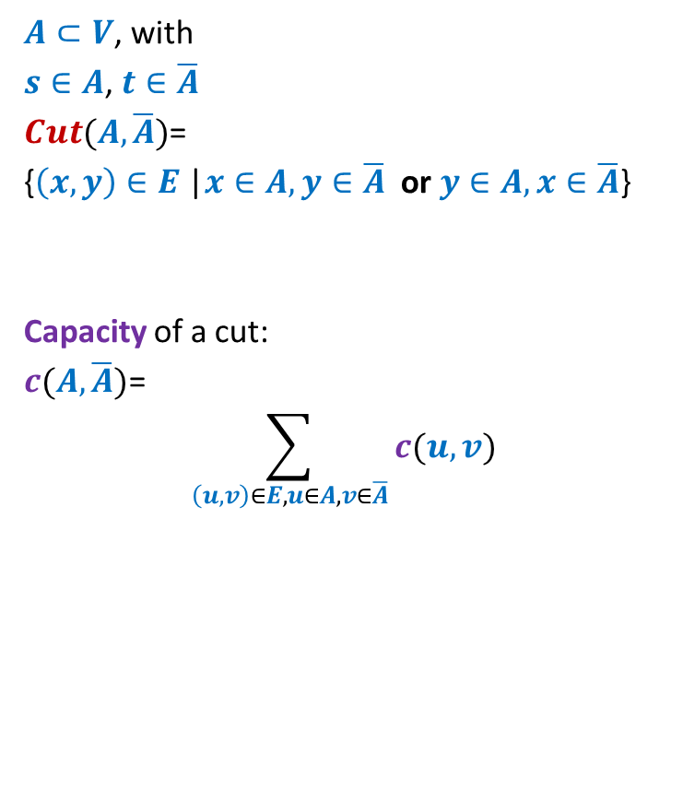
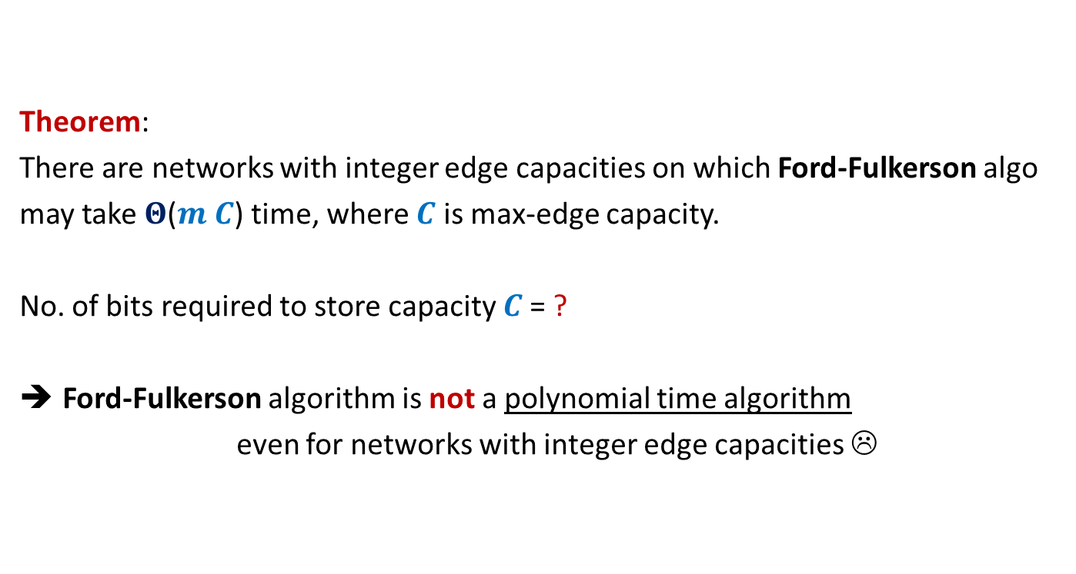

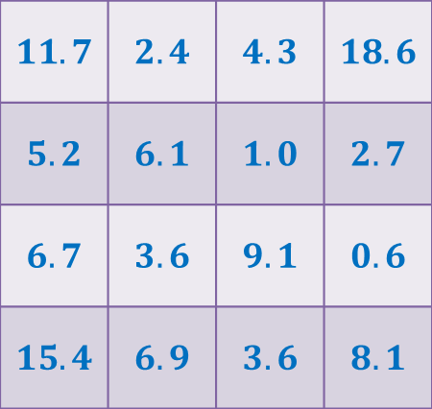

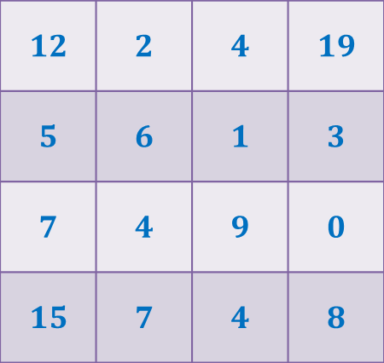
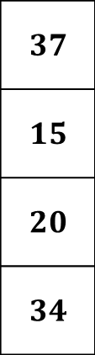
Rounding of a matrix
$$11$$
$$11.7$$
$$12$$
$$39$$ | $$19$$ | $$18$$ | $$30$$
$$37$$
$$15$$
$$20$$
$$34$$
$$11.7$$ | $$2.4$$ | $$4.3$$ | $$18.6$$
$$5.2$$ | $$6.1$$ | $$1.0$$ | $$2.7$$
$$6.7$$ | $$3.6$$ | $$9.1$$ | $$0.6$$
$$15.4$$ | $$6.9$$ | $$3.6$$ | $$8.1$$
$$12$$ | $$2$$ | $$4$$ | $$19$$
$$5$$ | $$6$$ | $$1$$ | $$3$$
$$7$$ | $$4$$ | $$9$$ | $$0$$
$$15$$ | $$7$$ | $$4$$ | $$8$$
Rounding always exists !
Rounding can be computed efficiently.
It was a homework.

Slide 8

Rounding of a matrix
Tool 1: Integrality of max-flow
Tool 2: An elementary observation
Max-Flow can not decrease if we increase the capacity of any set of edges.
Tool 3: A simple Homework exercise
If each matrix with entries $∈[0,1]$ can be rounded,
then each matrix can be rounded.

Slide 9



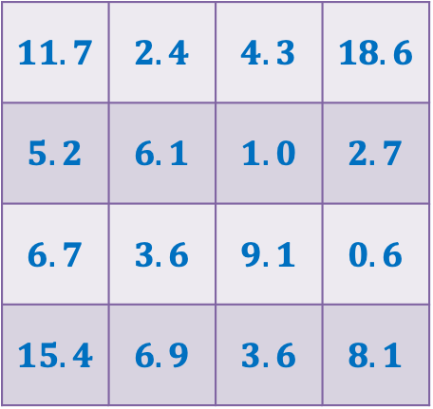


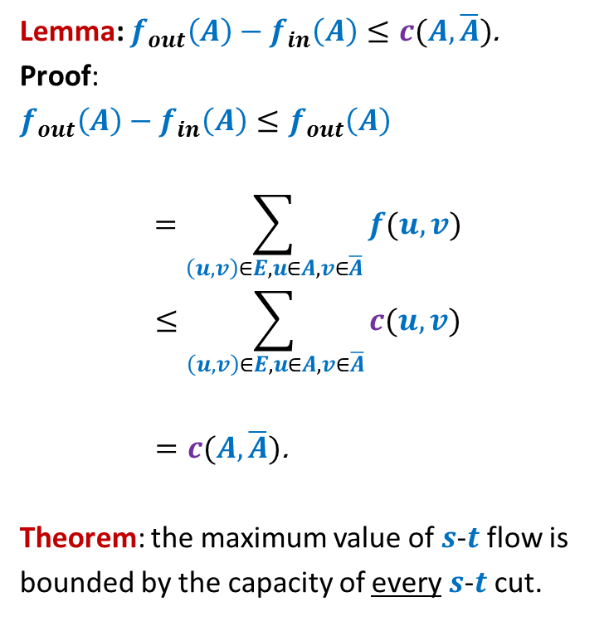








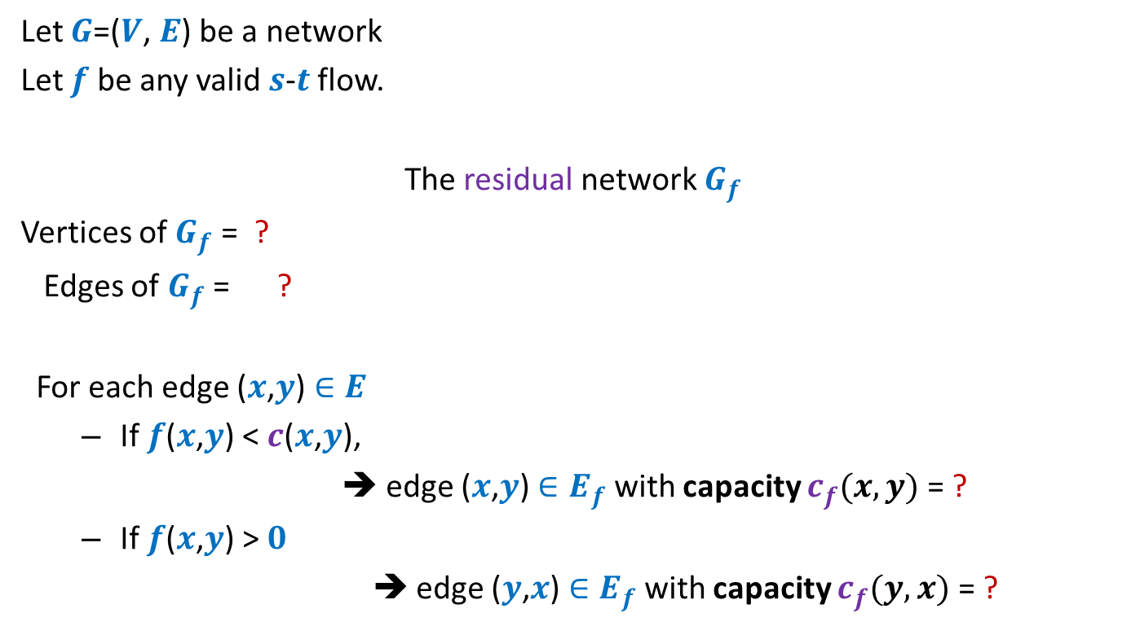
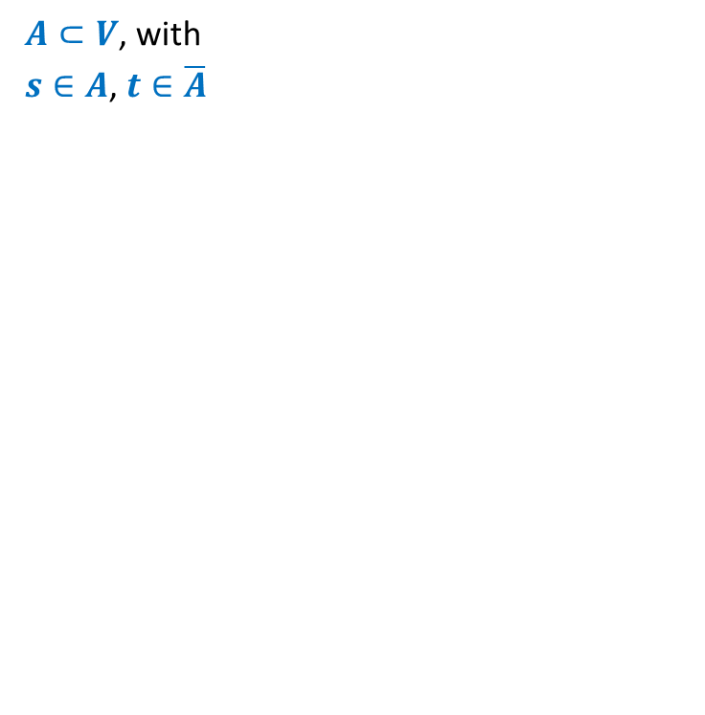

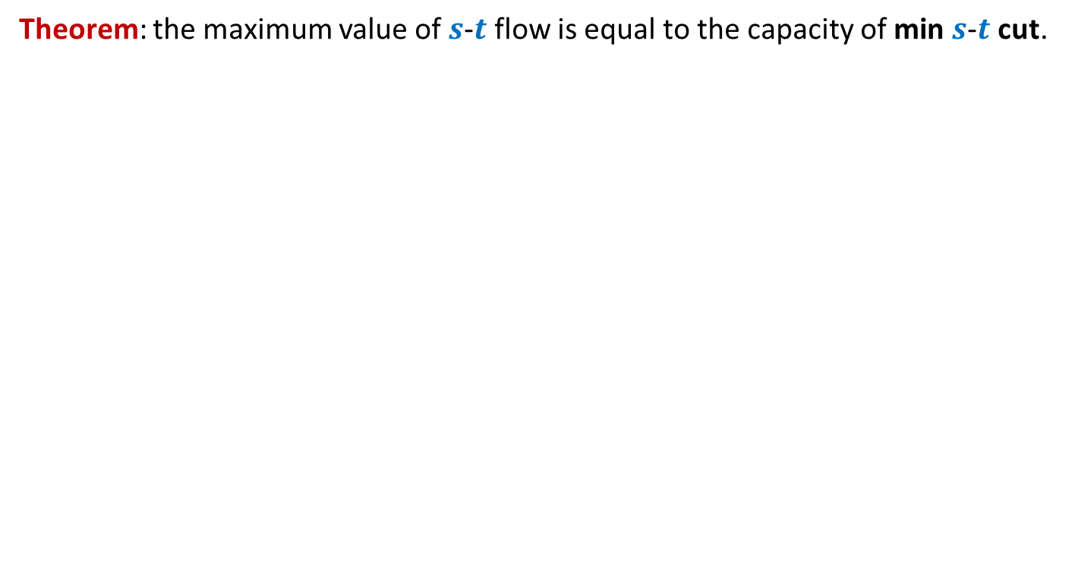

Rounding of a matrix
$$0$$
$$0.7$$
$$1$$
Tool 3
Tool 2
$$2$$ | $$2$$ | $$1$$ | $$2$$
Tool 1
rows
columns
$$11.7$$ | $$2.4$$ | $$4.3$$ | $$18.6$$
$$5.2$$ | $$6.1$$ | $$1.0$$ | $$2.7$$
$$6.7$$ | $$3.6$$ | $$9.1$$ | $$0.6$$
$$15.4$$ | $$6.9$$ | $$3.6$$ | $$8.1$$
$$2$$
$$1$$
$$2$$
$$2$$
$$0.7$$ | $$0.4$$ | $$0.3$$ | $$0.6$$
$$0.2$$ | $$0.1$$ | $$0.0$$ | $$0.7$$
$$0.7$$ | $$0.6$$ | $$0.1$$ | $$0.6$$
$$0.4$$ | $$0.9$$ | $$0.6$$ | $$0.1$$
$$1$$
$$0.2$$
$$2$$
$$2$$
$$1$$
$$0.1$$
$$2$$
$$1$$
$$0$$
$$2$$
$$0.0$$
$$1$$
$$0.7$$
$$1$$
$$2$$
$$2$$
What is the maximum flow in this network ?
$$7$$
Homework: Reproduce precise arguments we discussed in class on your own

Slide 10
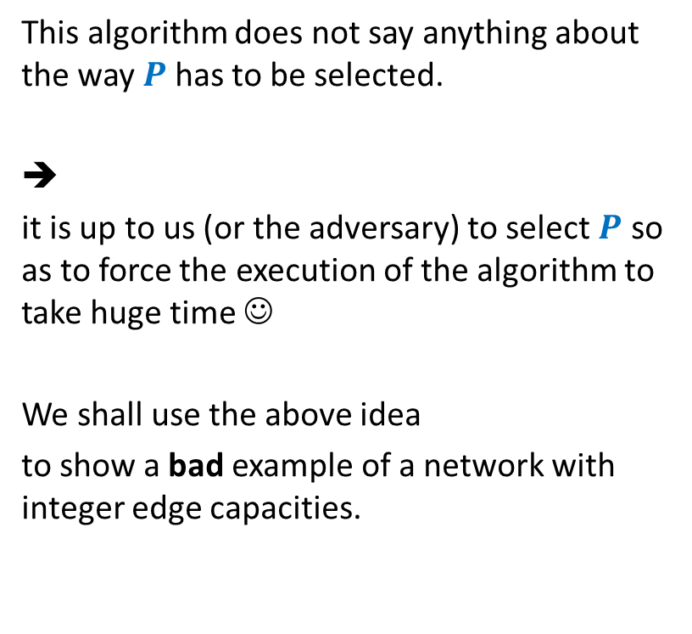
Ford Fulkerson algorithm
Ford-Fulkerson-algo($G$,$s$,$t$)
{ $f$← $0$;
While (there is $s$-$t$ path in $G_{f}$) do
{ Let $P$ be an $s$-$t$ path in $G_{f}$
Let$c′$ be bottleneck capacity of $P$;
For each ($x$,$y$) $∈P$ do
{ If ($x$,$y$) is a forward edge then
$f$($x$,$y$) ← $f$($x$,$y$) + $c′$;
Else
$f$($y$,$x$) ← $f$($y$,$x$) - $c′$;
}
} return $f$;
}
This algorithm does not say anything about the way $P$has to be selected.
➔
it is up to us (or the adversary) to select $P$ so as to force the execution of the algorithm to take huge time ☺
We shall use the above idea
to show a bad example of a network with integer edge capacities.

Slide 11


Ford Fulkerson algorithm
$P$ is any $s$-$t$ path
Ford-Fulkerson-algo($G$,$s$,$t$)
{ $f$← $0$;
While (there is $s$-$t$ path in $G_{f}$) do
{ Let $P$ be an $s$-$t$ path in $G_{f}$
Let$c′$ be bottleneck capacity of $P$;
For each ($x$,$y$) $∈P$ do
{ If ($x$,$y$) is a forward edge then
$f$($x$,$y$) ← $f$($x$,$y$) + $c′$;
Else
$f$($y$,$x$) ← $f$($y$,$x$) - $c′$;
}
} return $f$;
}
Adversary can exploit this fact to his/her
advantage to increase the no. of iterations.
Results:
Edge capacities are real numbers:
Number of iterations:
Edge capacities Integral :
Exponential no. of iterations
$$∞$$

Slide 12



A worst case example for networks with integer edge weights
$$G$$
$$G_{f}$$
$$x$$
$$x$$
1
1000
1000
1000
1000
$$s$$
1
1
$$t$$
$$s$$
1
$$t$$
1
1000
1000
1000
1000
$$y$$
$$y$$

Slide 13
A worst case example for networks with integer edge weights
$$G$$
$$G_{f}$$
$$x$$
$$x$$
1
1
1
1000
999
1000
1000
$$s$$
1
1
$$t$$
$$s$$
1
$$t$$
1
1
1000
1000
1000
999
1
$$y$$
$$y$$

Slide 14
A worst case example for networks with integer edge weights
$$G$$
$$G_{f}$$
$$x$$
$$x$$
1
1
1
1
2
1000
999
1000
999
$$s$$
1
1
$$t$$
$$s$$
1
$$t$$
1
2
1
1000
1000
999
999
1
1
$$y$$
$$y$$
The algorithm will run for 2000 iterations to compute max-flow !

Slide 15

Theorem:
There are networks with integer edge capacities on which Ford-Fulkerson algo
may take $Θ$($m C$) time, where $C$ is max-edge capacity.
No. of bits required to store capacity $C$= ?
Ford-Fulkerson algorithm is not a polynomial time algorithm
even for networks with integer edge capacities ☹
$$\log_{2}C$$

Slide 16

Polynomial time algorithms for Max-Flow
A natural question: How to achieve polynomial running time ?
Looking at the example 2 slides back, how should we pick path $P$ ?
➔
A natural idea:
Select the path of maximum capacity.
select the paths in Ford-Fulkerson algorithm cleverly

Slide 17
Polynomial Time algorithms for max-flow
Algorithm 1 For Networks with integer capacities

Slide 18


Algorithm 1
Algorithm-1($G$,$s$,$t$) {
Ford-Fulkerson-algo($G$,$s$,$t$) {
$f$← $0$;
While (there is $s$-$t$ path in $G_{f}$) do
{ Let $P$ be an $s$-$t$ path in $G_{f}$
Let$c′$ be bottleneck capacity of $P$;
For each ($x$,$y$) $∈P$ do
{ If ($x$,$y$) is a forward edge then
$f$($x$,$y$) ← $f$($x$,$y$) + $c′$;
Else
$f$($y$,$x$) ← $f$($y$,$x$) - $c′$;
}
} return $f$;
}
The entire analysis of this algorithm is provided by a sequence of hints in the worked out assignment 4 posted on the course website. Please go through it.
Let $P$ be the max-capacity $s$-$t$ path in $G_{f}$;

Slide 19
Algorithm 1
Algorithm-1($G$,$s$,$t$) {
Ford-Fulkerson-algo($G$,$s$,$t$) {
$f$← $0$;
While (there is $s$-$t$ path in $G_{f}$) do
{ Let $P$ be an $s$-$t$ path in $G_{f}$
Let$c′$ be bottleneck capacity of $P$;
For each ($x$,$y$) $∈P$ do
{ If ($x$,$y$) is a forward edge then
$f$($x$,$y$) ← $f$($x$,$y$) + $c′$;
Else
$f$($y$,$x$) ← $f$($y$,$x$) - $c′$;
}
} return $f$;
}
Assignment 4
Insight from
MaxFlow-MinCut Theorem.
Let $P$ be the max-capacity $s$-$t$ path in $G_{f}$;

Slide 20
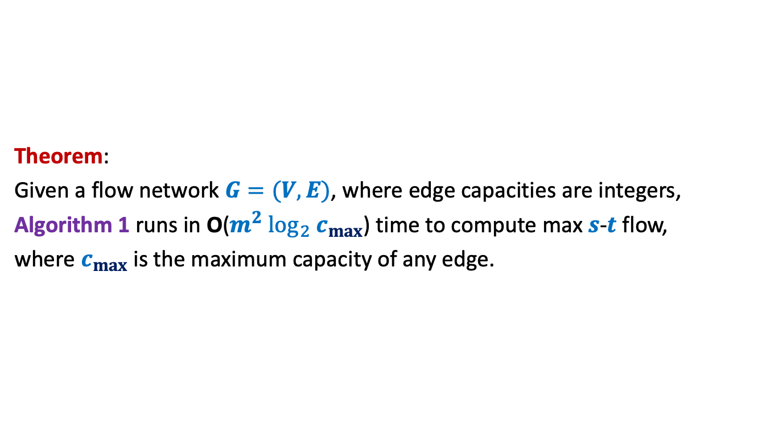
Algorithm 1
Theorem:
Given a flow network $G=(V,E)$, where edge capacities are integers,
Algorithm 1 runs in O($m^{2} \log_{2} c_{max}$) time to compute max $s$-$t$ flow,
where $c_{max}$ is the maximum capacity of any edge.

Slide 21

Polynomial Time algorithm for max-flow
Algorithm 2
For Networks with edge capacities $∈R^{+}$

Slide 22




Ford Fulkerson Algorithm
Ford-Fulkerson-algo($G$,$s$,$t$) {
$f$← $0$;
While (there is $s$-$t$ path in $G_{f}$) do
{ Let $P$ be an $s$-$t$ path in $G_{f}$
Let$c′$ be bottleneck capacity of $P$;
For each ($x$,$y$) $∈P$ do
{ If ($x$,$y$) is a forward edge then
$f$($x$,$y$) ← $f$($x$,$y$) + $c′$;
Else
$f$($y$,$x$) ← $f$($y$,$x$) - $c′$;
}
} return $f$;
}
Suppose each ($x_{0}$,$y_{0}$)is the bottleneck edge.
$$c′$$
$$x_{0}$$
$$y_{0}$$

Slide 23
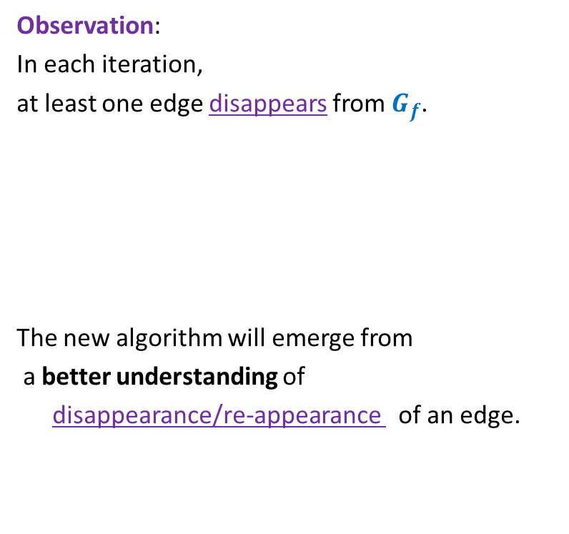

Ford Fulkerson Algorithm
Ford-Fulkerson-algo($G$,$s$,$t$) {
$f$← $0$;
While (there is $s$-$t$ path in $G_{f}$) do
{ Let $P$ be an $s$-$t$ path in $G_{f}$
Let$c′$ be bottleneck capacity of $P$;
For each ($x$,$y$) $∈P$ do
{ If ($x$,$y$) is a forward edge then
$f$($x$,$y$) ← $f$($x$,$y$) + $c′$;
Else
$f$($y$,$x$) ← $f$($y$,$x$) - $c′$;
}
} return $f$;
}
Observation:
In each iteration,
at least one edge disappears from $G_{f}$.
The new algorithm will emerge from
a better understanding of
disappearance/re-appearance of an edge.
But it may appear in $G_{f}$ again.

Slide 24

Disappearance of an edge in $G_{f}$

Slide 25














Disappearance of a forward edge
Flow must have increased along edge ($x$,$y$) up to $c$($x$,$y$).
➔ ($x$,$y$) must belong to the path $P$ selected during $i$th Iteration.
$$x$$
$$y$$
$$s$$
$$t$$
$$G_{f}$$
$$x$$
$$y$$
After $i$th Iteration
$$x$$
$$y$$
$$s$$
$$t$$
$$G_{f′}$$
$$x$$
$$y$$

Slide 26







Disappearance of a backward edge
Flow must have decreased along edge ($y$,$x$) to 0.
➔ ($x$,$y$) must belong to the path $P$ selected during $i$th Iteration.
$$y$$
$$x$$
$$s$$
$$t$$
$$G_{f}$$
$$x$$
$$y$$
After $i$th Iteration
$$y$$
$$x$$
$$s$$
$$t$$
$$G_{f′}$$
$$x$$
$$y$$

Slide 27
the (RE-)appearance of an edge

Slide 28










(Re)-Appearance of a forward edge
Flow must have reduced along edge ($x$,$y$) to less than $c$($x$,$y$).
➔ ($y$,$x$) must belong to the path $P$ selected during $i$th Iteration.
$$x$$
$$y$$
$$s$$
$$t$$
$$G_{f}$$
$$x$$
$$y$$
After $i$th Iteration
$$x$$
$$y$$
$$s$$
$$t$$
$$G_{f′}$$
$$x$$
$$y$$

Slide 29


(Re)-appearance of a backward edge
Flow must have increased along edge ($y$,$x$) after ith iteration.
➔ ($y$,$x$) must belong to the path $P$ selected during $i$th Iteration.
$$y$$
$$x$$
$$s$$
$$t$$
$$G_{f}$$
$$x$$
$$y$$
After $i$th Iteration
$$y$$
$$x$$
$$s$$
$$t$$
$$G_{f′}$$
$$x$$
$$y$$

Slide 30
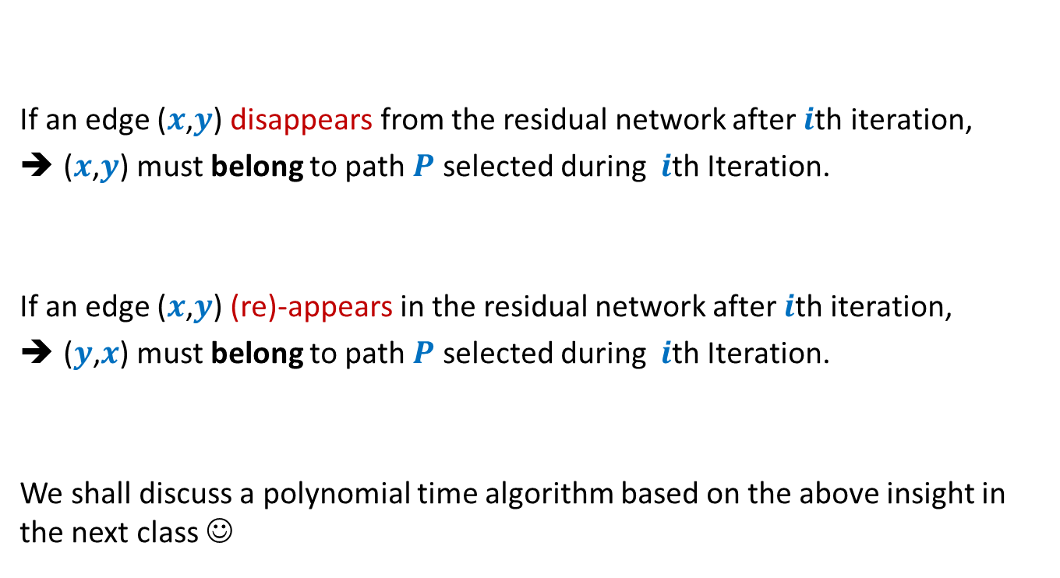
Disappearance/Reappearance of an edge in residual network
If an edge ($x$,$y$) disappears from the residual network after $i$th iteration,
($x$,$y$) must belong to path $P$ selected during $i$th Iteration.
If an edge ($x$,$y$) (re)-appears in the residual network after $i$th iteration,
($y$,$x$) must belong to path $P$ selected during $i$th Iteration.
We shall discuss a polynomial time algorithm based on the above insight in the next class ☺

Slide 31
An example to show that Ford-Fuklerson algorithm might not even terminate
This topic is totally optional. Study it if you have any interest in maximum flows
(beyond just good grade)

Slide 32


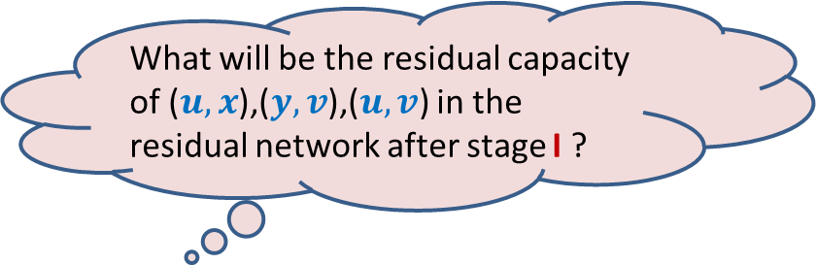
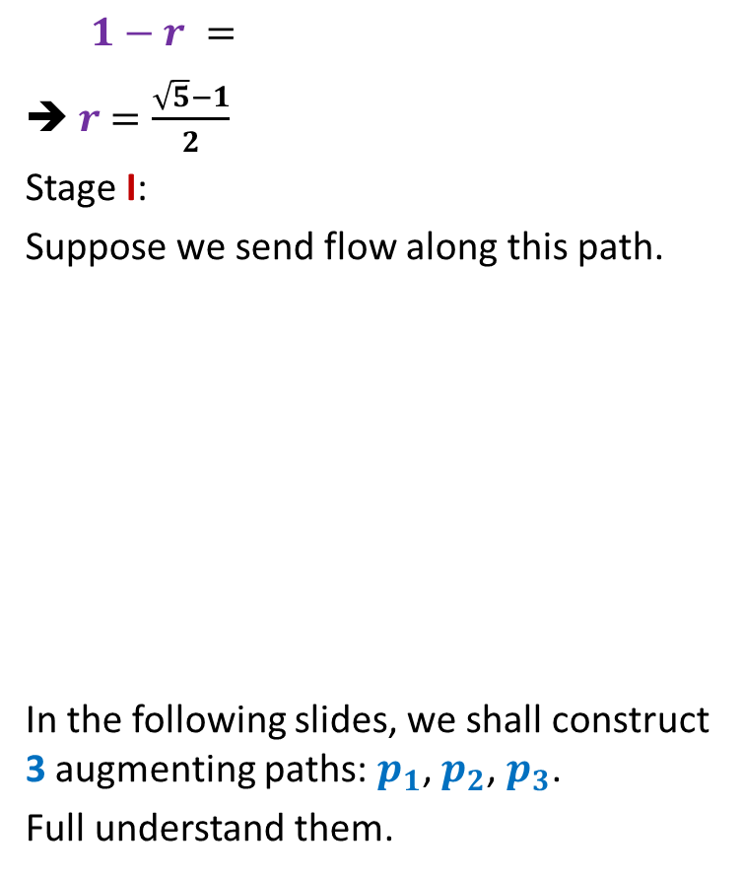



A non-terminating example for networks with real edge weights
$$G$$
$$x$$
Max-flow = 5
$1−r =$
➔ $r$ $=\frac{\sqrt{5}−1}{2}$
Stage I:
Suppose we send flow along this path.
In the following slides, we shall construct 3 augmenting paths: $p_{1}$, $p_{2}$, $p_{3}$.
Full understand them.
$$r^{2}$$
2
1
2
$$u$$
$$s$$
2
What will be the residual capacity of ($u,x$),($y,v$),($u,v$) in the residual network after stage I ?
$$t$$
1
2
$$v$$
2
2
$$r$$
[$r^{0}$, $r^{1}$, $0$]
$$y$$

Slide 33


A non-terminating example for networks with real edge weights
$$G$$
$$x$$
Max-flow = 5
$1−r =$
➔ $r$ $=\frac{\sqrt{5}−1}{2}$
$$r^{2}$$
$$u$$
$$s$$
$$t$$
This is $p_{1}$.
$$v$$
$$y$$

Slide 34
A non-terminating example for networks with real edge weights
$$G$$
$$x$$
Max-flow = 5
$1−r =$
➔ $r$ $=\frac{\sqrt{5}−1}{2}$
$$r^{2}$$
$$u$$
$$s$$
$$t$$
This is $p_{2}$.
$$v$$
$$y$$

Slide 35
A non-terminating example for networks with real edge weights
$$G$$
$$x$$
Max-flow = 5
$1−r =$
$r$ $=\frac{\sqrt{5}−1}{2}$
Suppose after stage I, we select the next 4 augmenting paths as $p_{1}$, $p_{2}$, $p_{1}$, $p_{3}$.
Repeat sequence <$p_{1}$, $p_{2}$, $p_{1}$, $p_{3}$> infinitely
$$r^{2}$$
This is $p_{3}$.
$$u$$
$$s$$
$$t$$
What will be the residual capacity of ($u,x$),($y,v$),($u,v$) in $G_{f}$ at this stage ?
$$v$$
$$y$$
[$r^{2}$, $r^{3}$, $0$]
Make right inferences now ☺

Slide 36
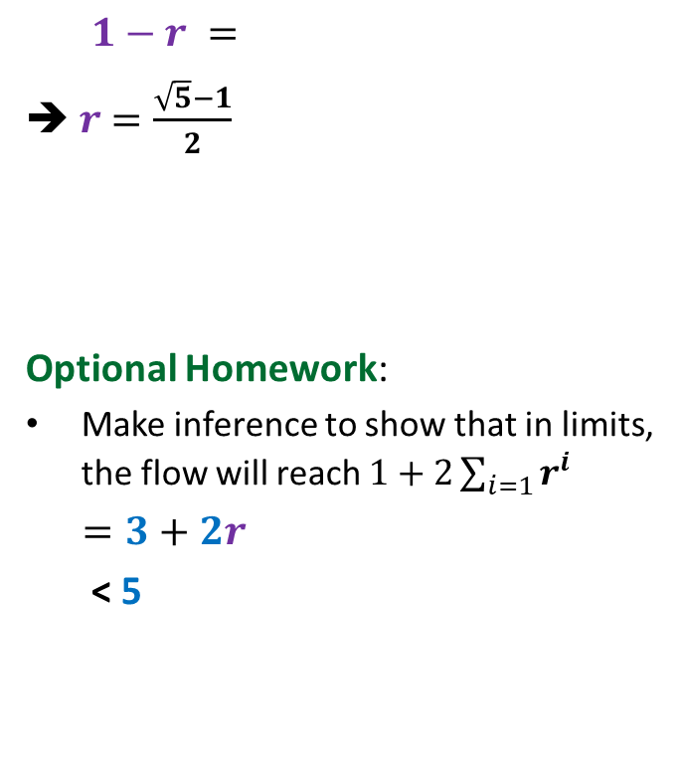
A non-terminating example for networks with real edge weights
$$G$$
$$x$$
Max-flow = 5
$1−r =$
➔ $r$ $=\frac{\sqrt{5}−1}{2}$
Optional Homework:
Make inference to show that in limits, the flow will reach $1+2\sum_{i=1}{r^{i}}$
$=3+2r$
< 5
$$r^{2}$$
2
1
2
$$u$$
$$s$$
2
$$t$$
1
2
$$v$$
2
2
$$r$$
$$y$$

Slide 37

Theorem:
There exists a network with 6 nodes and 9 edges and capacities ${∈R}^{+}$on which Ford Fulkerson may never terminate !

